Slide 1
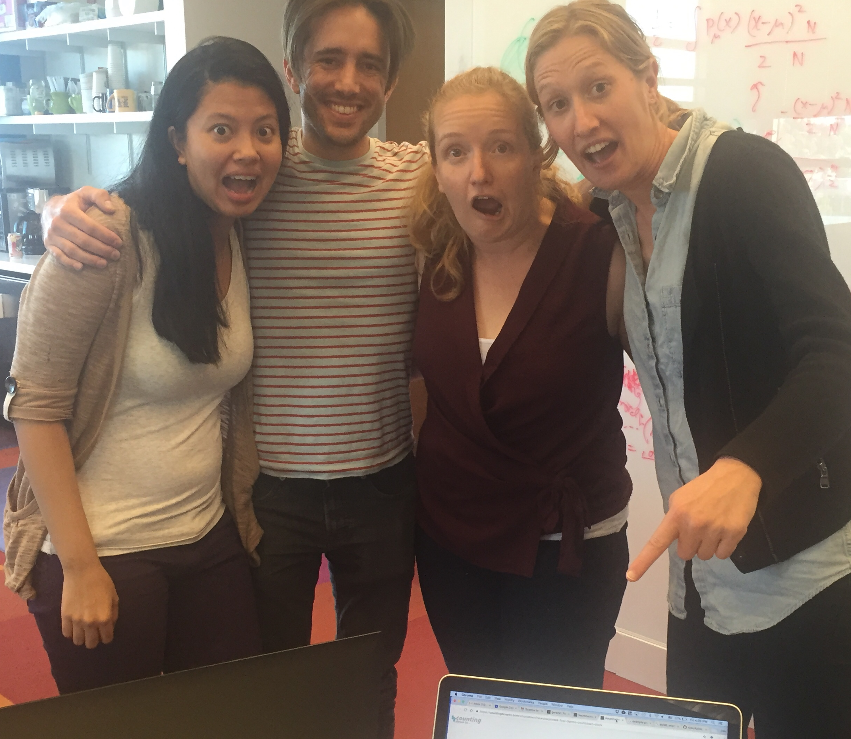
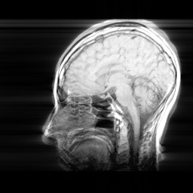
Exploring methodological issues in developmental imaging with large data
Solve this in 4 days!
https://github.com/neurohackweek/kids

Slide 2
The problem!
Developmental data is noisy! Lot’s of motion
Sample sizes are usually small
The brain is changing during development at differential rates per person (e.g. not all 6 year old brains are at the same stage of development).
What are the best practices for developmental imagers to yield reliable and reproducible results?

Slide 3
Question 1: motion
How much motion is too much motion for reproducible results?
Many developmental rsfmri studies in kids set an arbitrary threshold for % motion outliers (usually 20%)
We know increased motion has resulted in decreased long distance functional connectivity (Van Dijk et al., 2011)
Yet no one, to our knowledge, has empirically tested how much motion is too much motion to create reliable results. In other words, is 20% motion outliers the correct cut off?

Slide 4
100%
10%
20%
Reliability
50%
0
50
% bad motion

Slide 5
Question 2: motion and sample size
Can we tolerate more motion in larger sample sizes?
In other words, should motion thresholds differ by sample size?

Slide 6
100%
10%
20%
Reliability
N = 400
N = 60
50%
0
50
% bad motion

Slide 7
Question 3: motion and sample size by age?
Considering that brains are differentially growing, do both motion and sample size cut offs differ by age?
There might be more variance in younger brains than older brains, leading to perhaps a need for more stringent motion thresholds/ larger sample sizes
Ages: 14-16
Ages: 6-8
100%
100%
10%
20%
5%
15%
Reliability
Reliability
N = 400
N = 400
N = 60
N = 60
50%
50%
0
% bad motion
50
0
% bad motion
50

Slide 8
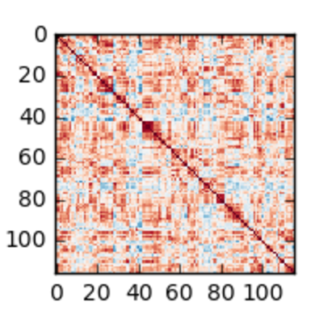
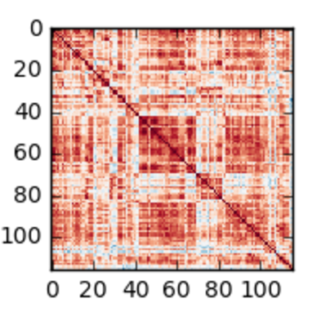
Methods
Dataset: 793 children from ABIDE data set (Craddock & Bellec)
AAL ROI-ROI corr mat
Motion thresh?
Sample size?
Age?
Group A
Filtered
data
data
Group B
Group B ROI-ROI
Output: R² between data and unity line for each permutation
Group A ROI-ROI
Notes:
Groups are balanced by age, sex, diagnosis and site

Slide 9
Results!
Kind of…

Slide 10
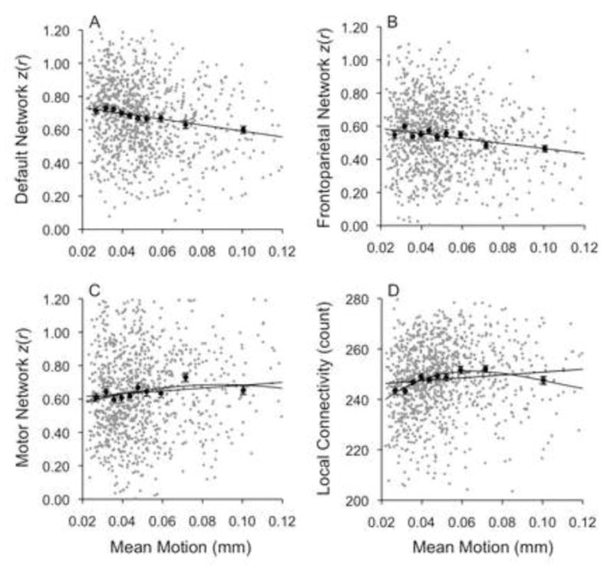
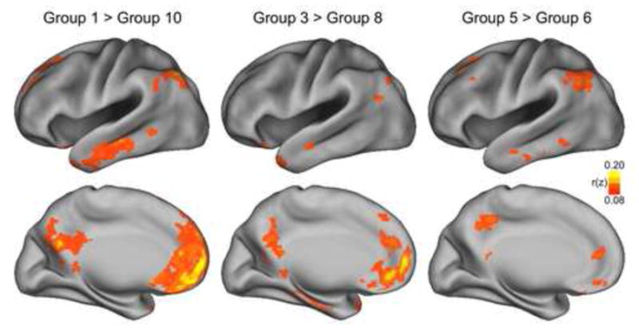
Future directions
Sanity check: past work has shown that motion decreases long range connectivity and increases short range connectivity (Van Dijk et al., 2011). Do we find this in our analysis as well?

Slide 11
Future directions
A tool for others:
Easy methods for using other data-sets
Flexibly pass in custom methods for generating comparison measure

